Slide 1

MOVIE REVIEW SENTIMENT ANALYSIS INTEGRATED WITH DIALOGFLOW
Ahmed Hallaba Bassel Emam
Kamel El-Sehly

Slide 2

Index
Objectives
Introduction
Feature Engineering
Classification Models
Clustering Models
Chatbot
Error Analysis
Conclusion

Slide 3
Objectives
This project aims to classify the sentiment analysis of the movie reviews whether positive or negative, integrated through the user interface of a dialog-flow chatbot.

Slide 4
Introduction
Sentiment analysis is a machine learning technique to identify the sentiment of the sentence through NLP, we will use this technique in the movies’ reviews, we train our model from IMDB-Dataset having 50K movie reviews for natural language processing or Text analytics, this is a dataset for binary sentiment classification.

Slide 5
Feature Engineering
BOW
TF-IDF
LDA
Paragraph Vector (Doc2Vec)
BERT

Slide 6
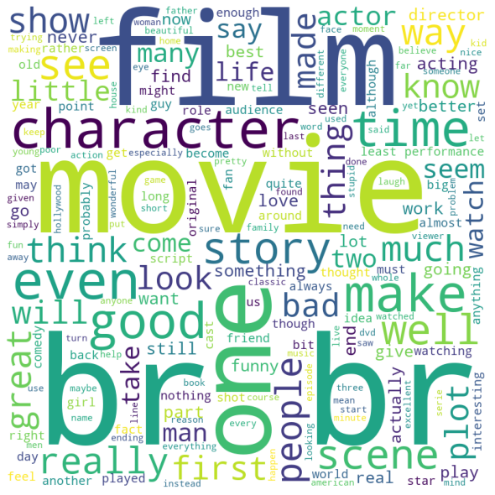
BOW

Slide 7
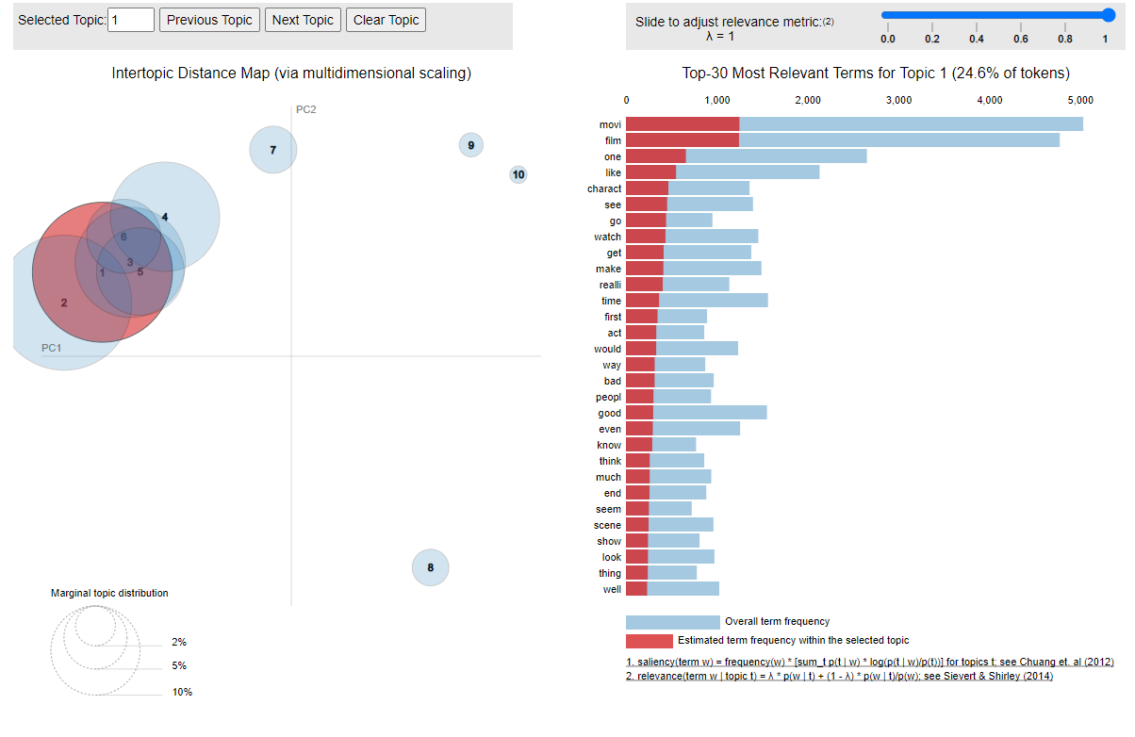
LDA

Slide 8
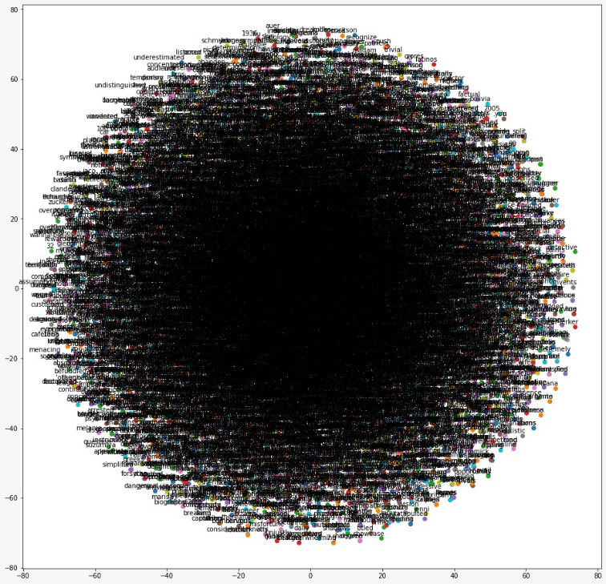
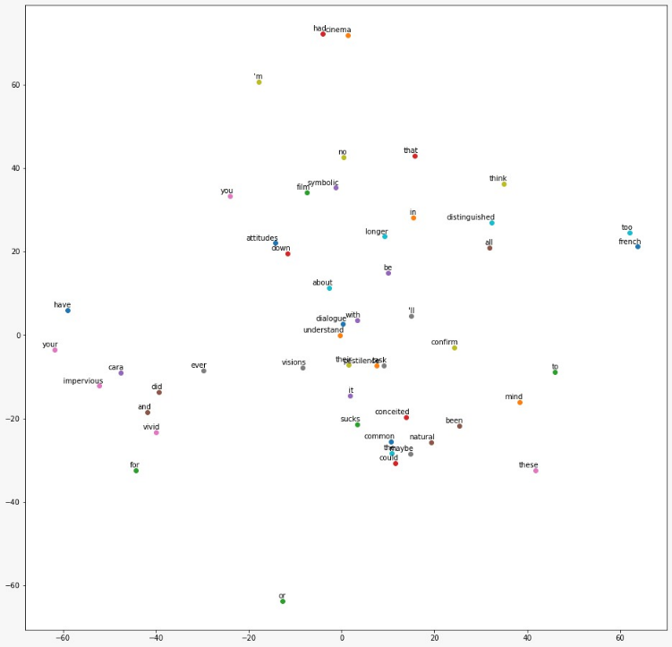
Paragraph Vector (Doc2Vec)

Slide 9
Classification Models
 | BOW | TF-IDF | LDA | BERT | Doc2Vec
Gaussian NB | 0.592 | 0.602 | 0.692 | 0.756 | 0.824
Bernoulli NB | 0.832 | 0.832 | 0.53 | 0.76 | 0.8266
Decision Tree | 0.698 | 0.696 | 0.582 | 0.668 | 0.8013
Random Forest | 0.8 | 0.778 | 0.71 | 0.772 | 0.82
SVM | 0.852 | 0.866 | 0.71 | 0.82 | 0.828

Slide 10
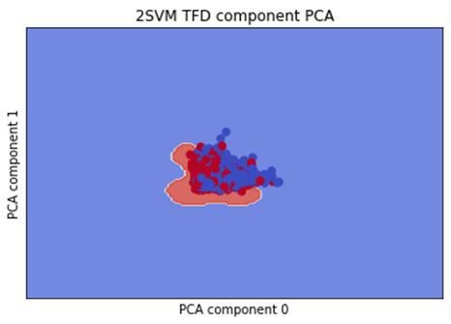
Classification Models
Champion classification model: SVM with TF-IDF

Slide 11
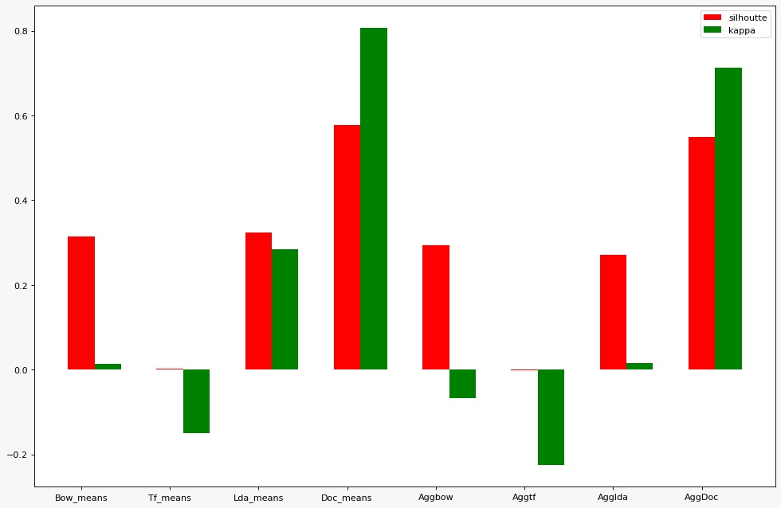
Clustering Models
 | BOW | TFD | LDA | BERT | Doc2Vec
K-Means | 57.64 | 65.64 | 50.36 | 51.72 | 80.2
A-Clustering | 54.56 | 64.2 | 50 | 51.72 | 70.8

Slide 12
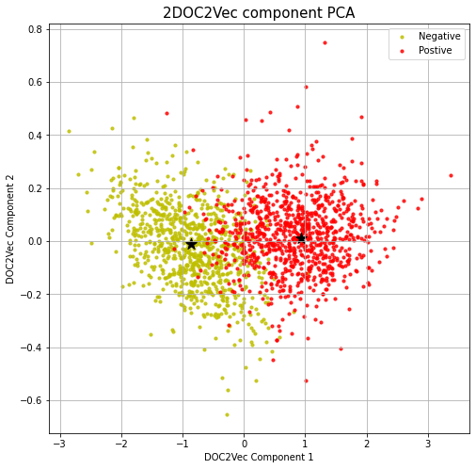
Clustering Models
Champion Clustering model: K-Means with Doc2Vec

Slide 13
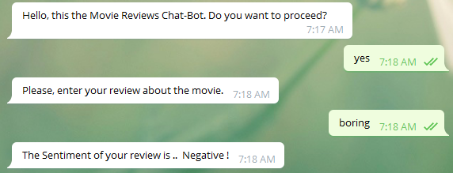
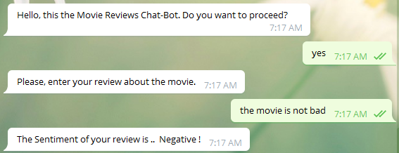
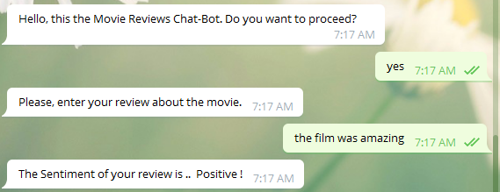
Chatbot

Slide 14
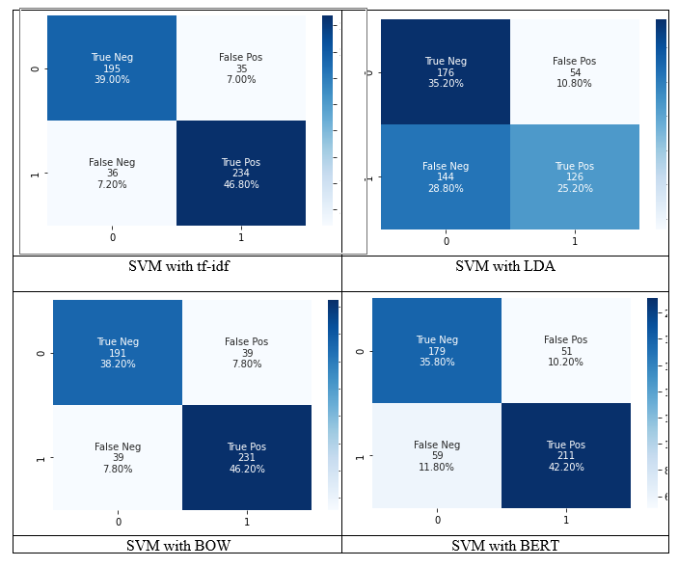
Error Analysis on predictions

Slide 15
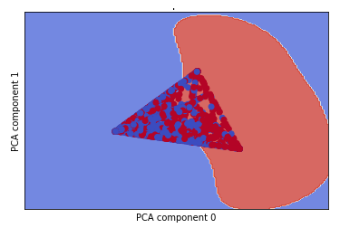
Error Analysis on predictions

Slide 16
Error Analysis on Data
We faced a problem with data, we couldn’t apply all of our dataset (just 5% of the total dataset could be used) because of the limited processing resources.
Why could this make a problem?
As we know that data is the fuel of machine learning so the more you feed the model the more accuracy your model will get (of course to a particular limit not to fall in over fitting)

Slide 17
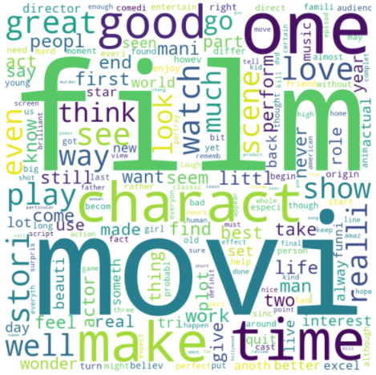
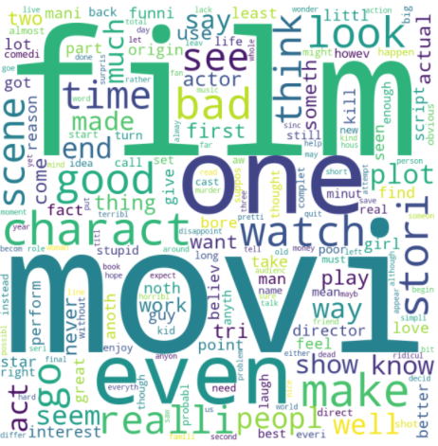
Error Analysis on Features
Positive Sentiment
Negative Sentiment

Slide 18
Conclusion
To sum up what was done in this project, the TF-IDF algorithm with the SVM classifier was found to be the best classification model with accuracy 82.6 %, also the Doc2Vec algorithm with the K-Means is the best clustering model with accuracy 80.2 %, after determining the best models we go through the application that can integrate the chatbot with the ML models, the SVM using TF-IDF is the model used in the deployment as it has the highest testing accuracy.
This project is just a first step in the movie reviews sentiment analysis application, it could be improved by adding many features like the movie name, movie type, and movie rating. These extra features could be implemented in the future that will help movies platforms to easily reach the spectators and can get their review as fast and genuine as possible. This approach could help in understand the sense of the audience, which will help in developing more efficient recommender systems.

Slide 19

Thank you

